Slide 1
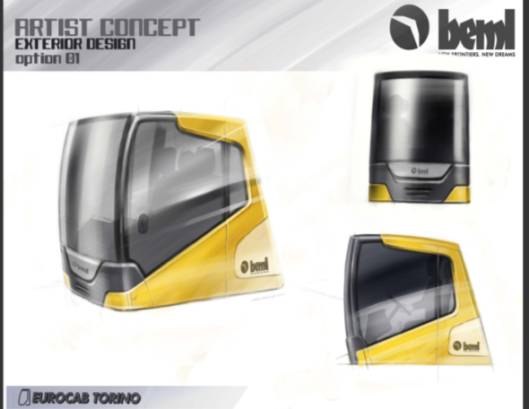
BEML APPROVED CONCEPT
ROOF SHOUD BE CLOSED – NO GLASS ON TOP.
FRONT GRILL MOUNTING SHOULD BE OPEN TYPE AND NOT SHOWN IN THE CONCEPT
WIPRMOTOR CONSOLE IS TO BE PROVIDED
THIS ANGLE CAN BE 72º TO 80º
POWER WINDOW HAS TO BE PROVIDED

Slide 2
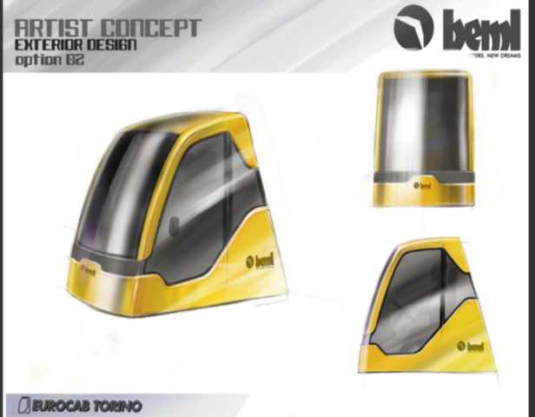
BEML APPROVED CONCEPT
ROOF SHOUD BE CLOSED – NO GLASS ON TOP.
SLOPE IN FRONT SHOULD BE FULL SHEET
FRONT GRILL MOUNTING SHOULD BE OPEN TYPE AND NOT SHOWN IN THE CONCEPT
ROOF EXTENSION HAS TO BE MADE
WIPRMOTOR CONSOLE IS TO BE PROVIDED
THIS ANGLE CAN BE 72º TO 80º
POWER WINDOW HAS TO BE PROVIDED

Slide 3
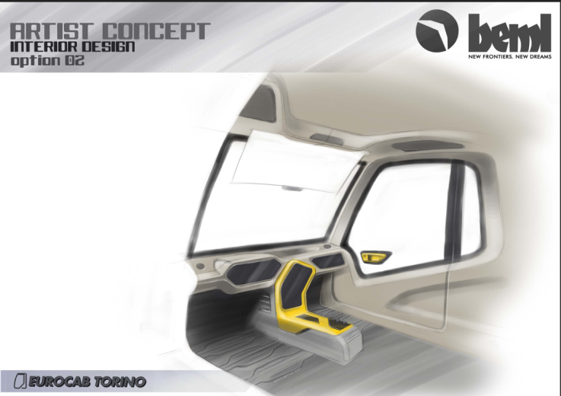
BEML APPROVED CONCEPT
BOTTLE HOLDER SHOUD BE BELOW THE AC DUCTING AND TOWARDS THE DOOR OR REAR SIDE.

Slide 4
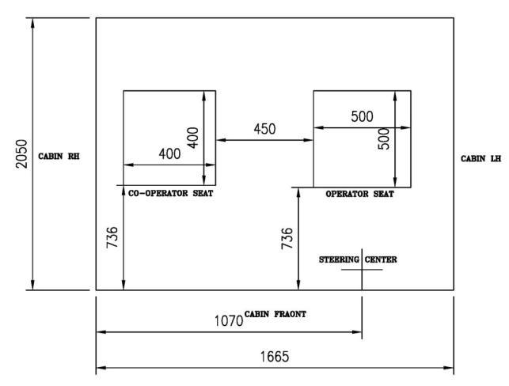
Operator & Co-Operator Seat Location

Slide 5
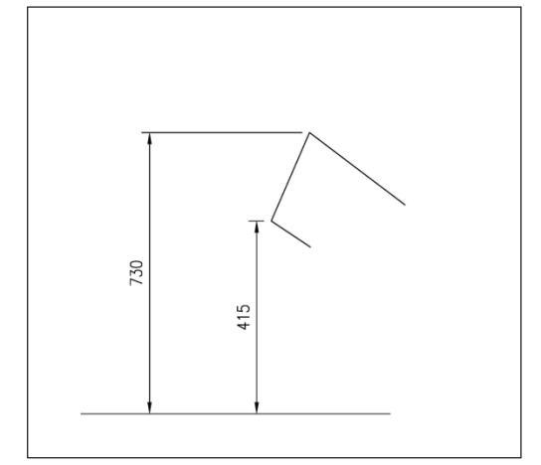
Dash Board Height from Floor

Slide 6
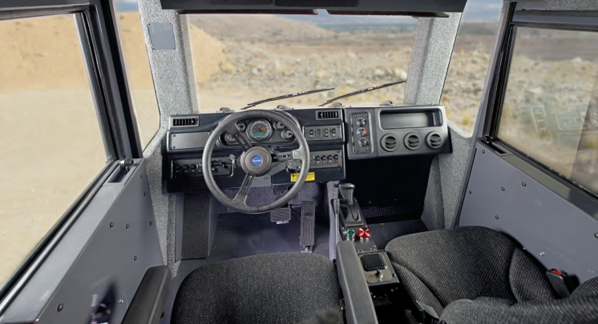
Instrument Panel details

Slide 7
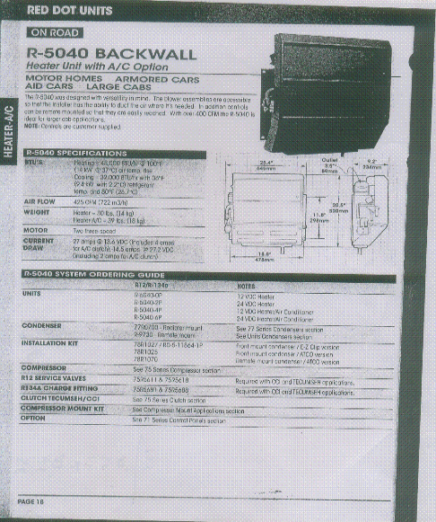
AC DETAILS

Slide 8
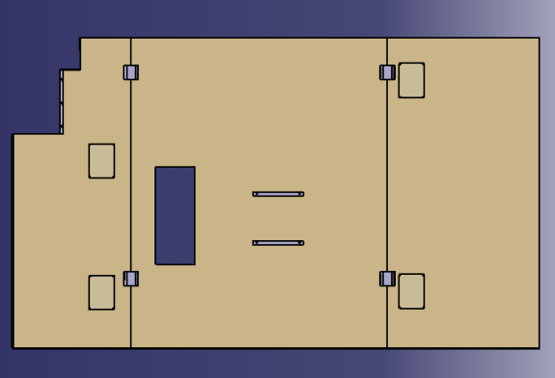
VISCUOS MOUNT DETAILS
Steering , break, clutch cut-out
Structure welding points.
Viscous mounting point
Seat mounting.
Refer IGS file for dimensions.

Slide 9
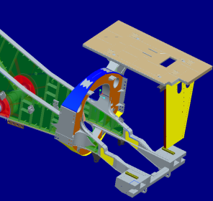
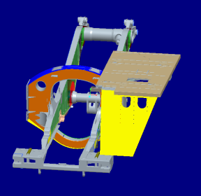
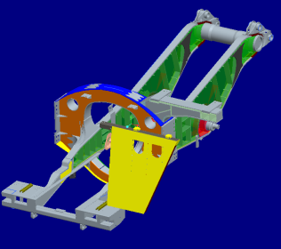
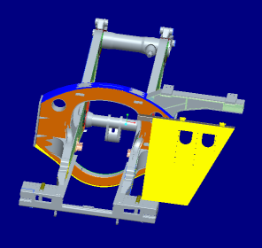
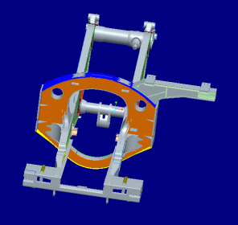
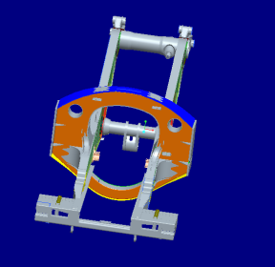
ROPS DETAILS

Slide 10
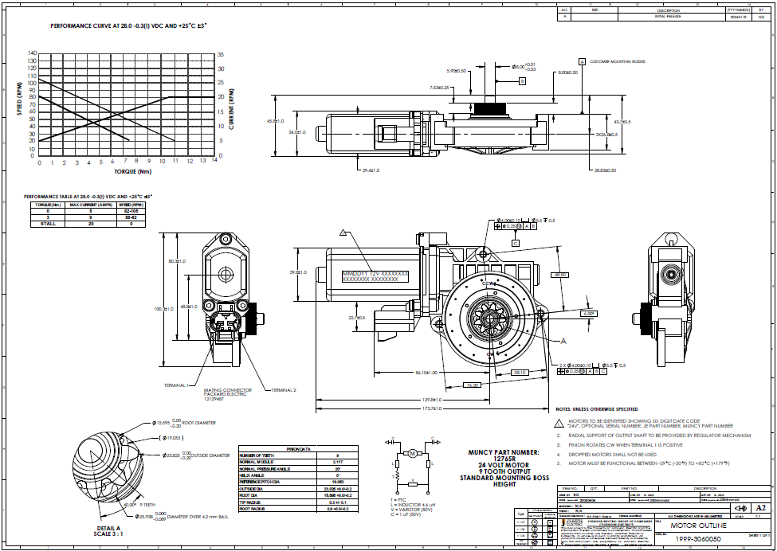
POWER WINDOW

Slide 11
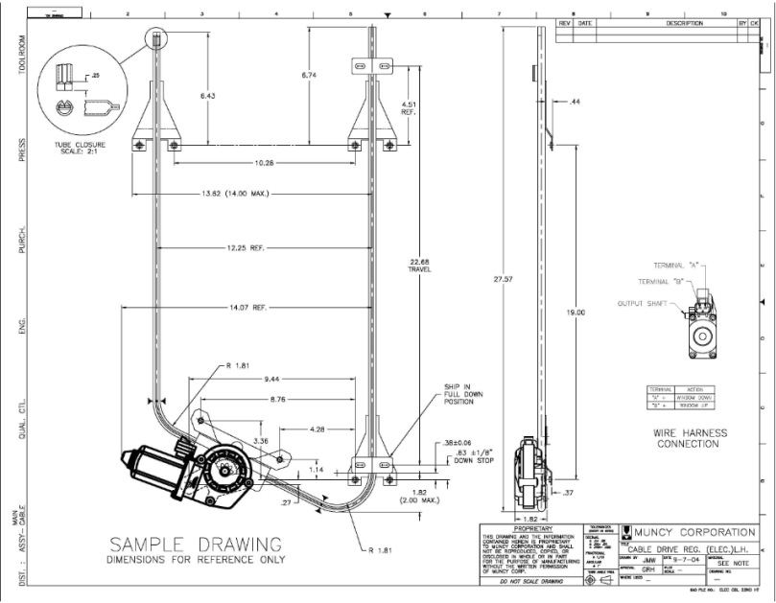
POWER WINDOW

Slide 12
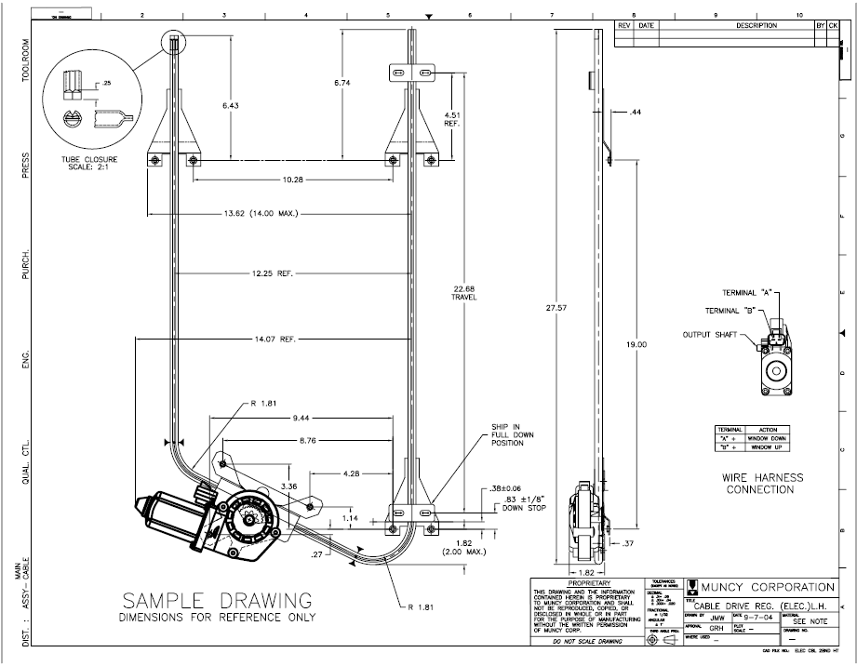
POWER WINDOW

Slide 13
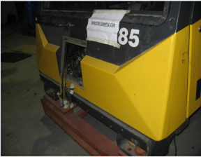
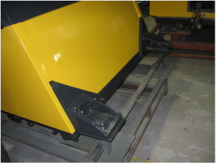
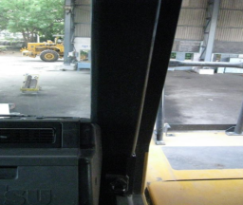
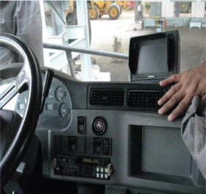
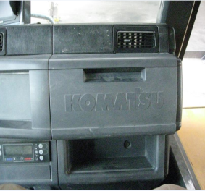
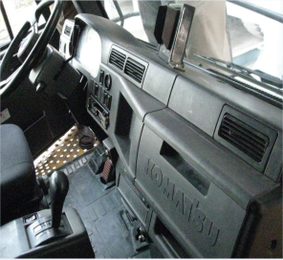
BENCHMARKING MODELS

Slide 14
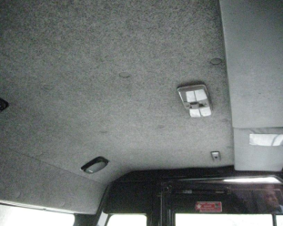
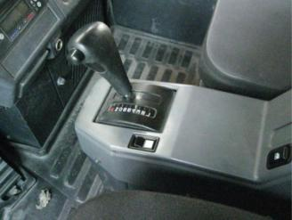
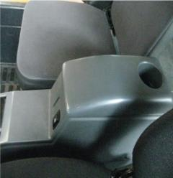
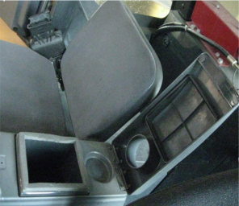
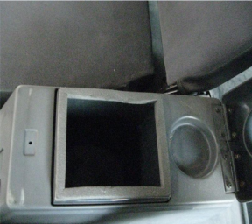
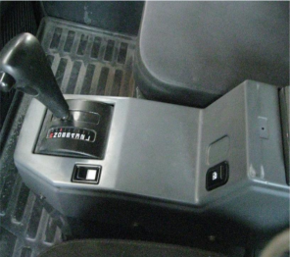
BENCHMARKING MODELS

Slide 15
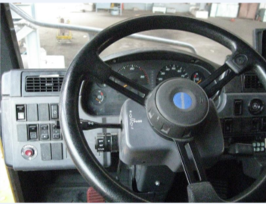
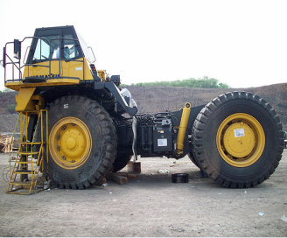
BENCHMARKING MODELS

Slide 16
Operating temperature Range
1) Operating Temperature Range – Maximum - 50°C

Slide 17
ROPS test
ROPS test to be done for the Cabin not for the Body

Slide 18
Position of instruments and lever
Shift lever on floor, comes right side to Operator seat ergonomic design to be Arrived by yourself.

